Slide 1
SOCIAL STUDIES
9th grade
Subject For High School
Individuality and Conformity
Here is where your presentation begins

Slide 2
CONTENTS OF THIS TEMPLATE
Here’s what you’ll find in this Slidesgo template:
A slide structure based on a multi-purpose presentation for education, which you can easily adapt to your needs. For more info on how to edit the template, please visit Slidesgo School or read our FAQs.
An assortment of graphic resources that are suitable for use in the presentation can be found in the alternative resources slides.
A thanks slide, which you must keep so that proper credits for our design are given.
A resources slide, where you’ll find links to all the elements used in the template.
Instructions for use and final slides with:
The fonts and colors used in the template.
A selection of illustrations. You can also customize and animate them as you wish with the online editor. Visit Storyset to find more.
More infographic resources, whose size and color can be edited.
Sets of customizable icons of the following themes: general, business, avatar, creative process, education, help & support, medical, nature, performing arts, SEO & marketing, and teamwork.
You can delete this slide when you’re done editing the presentation.

Slide 3
INTRODUCTION
You can give a brief description of the topic you want to talk about here. For example, if you want to talk about Mercury, you can say that it’s the smallest planet in the entire Solar System

Slide 4
—SOMEONE FAMOUS
“This is a quote, words full of wisdom that someone important said and can make the reader get inspired.”

Slide 5
TABLE OF CONTENTS
01
03
02
04
Conformity
Difference
You can describe the topic of the section here
You can describe the topic of the section here
Individuality
Society
You can describe the topic of the section here
You can describe the topic of the section here

Slide 6
01
CONFORMITY
You can enter a subtitle here if you need it

Slide 7
WHAT IS CONFORMITY?
Compliance
Identification
Internalization
It’s the closest planet to the Sun and the smallest one
Venus has a nice name and is the second planet from the Sun
Mars is actually a cold place. It’s full of iron oxide dust

Slide 8
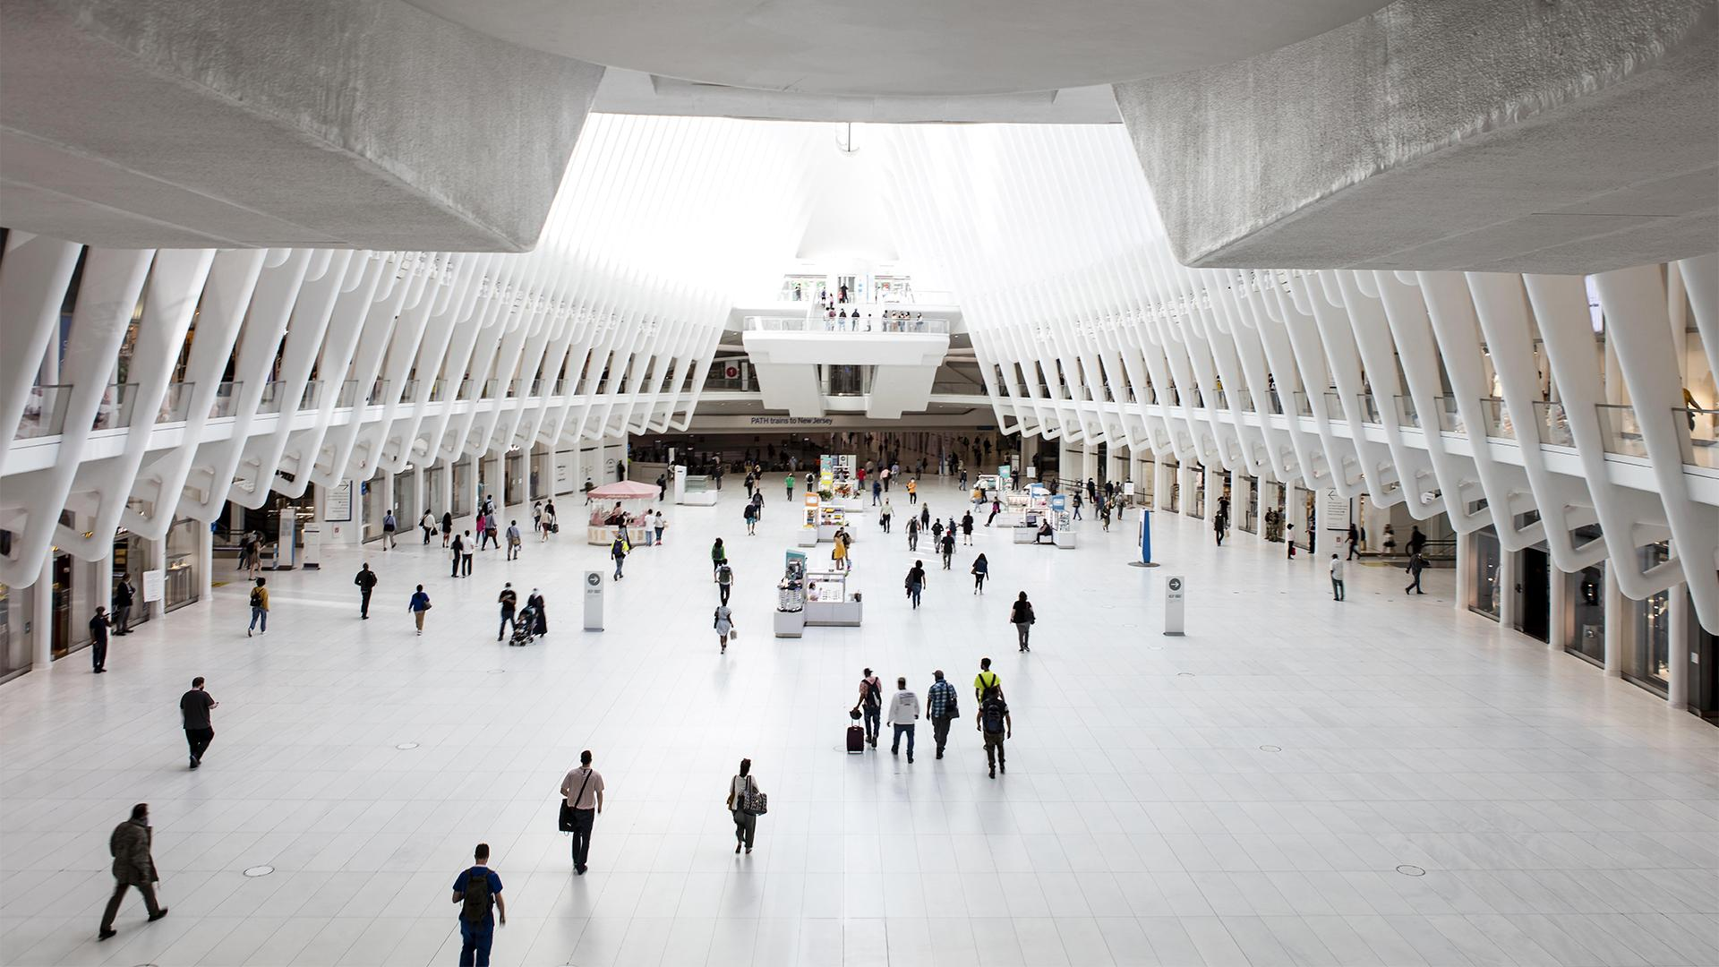
A PICTURE ALWAYS REINFORCES THE CONCEPT
Images reveal large amounts of data, so remember: use an image instead of a long text. Your audience will appreciate it

Slide 9
FEATURES OF CONFORMITY
Include
Consent
Despite being red, Mars is actually a cold place. It's full of iron oxide dust, which gives the planet its reddish cast
Venus has a beautiful name and is the second planet from the Sun. It has an extremely poisonous atmosphere

Slide 10
TYPES OF CONFORMITY
Jupiter
Neptune
Jupiter is the biggest planet in the Solar System
It's the fourth-largest planet by diameter in the Solar System
Venus
Mercury
It has a nice name and is the second planet from the Sun
It’s the closest planet to the Sun and the smallest one
Mars
Saturn
Despite being red, Mars is actually a cold place
Saturn is composed mostly of hydrogen and helium

Slide 11
AM I A CONFORMIST PERSON?
Do you consider yourself a leader?
Would you like to look like the rest?
No
Yes
Yes
No
Do you care what others think?
No
Yes
Individuality
Conformist

Slide 12
EXERCISE 1
Select the correct answer
01
03
Latin word for conformity
Synonyms of conformity
Conformare
(select multiple answers)
Individualitas
Selfhood
Societatis
Consent
02
Allegiance
Synonyms of individuality
Identity
Obedience
Identity
Obedience

Slide 13
02
INDIVIDUALITY
You can enter a subtitle here if you need it

Slide 14
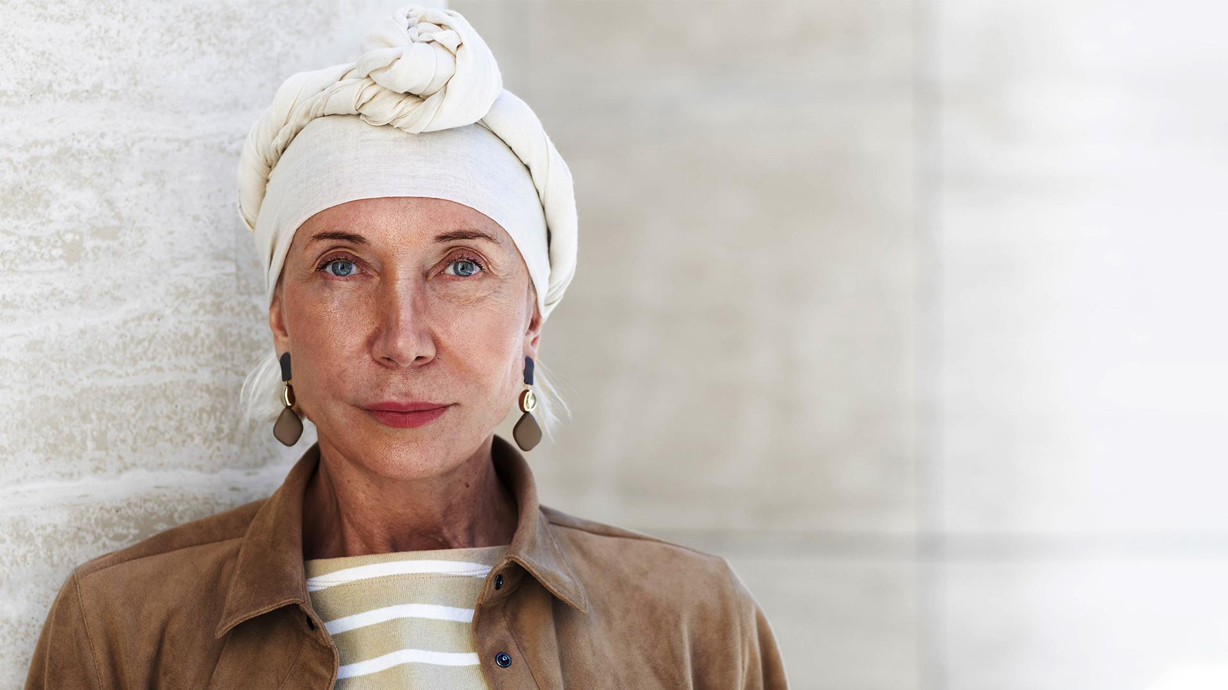
A PICTURE IS WORTH A THOUSAND WORDS

Slide 15
AWESOME WORDS

Slide 16
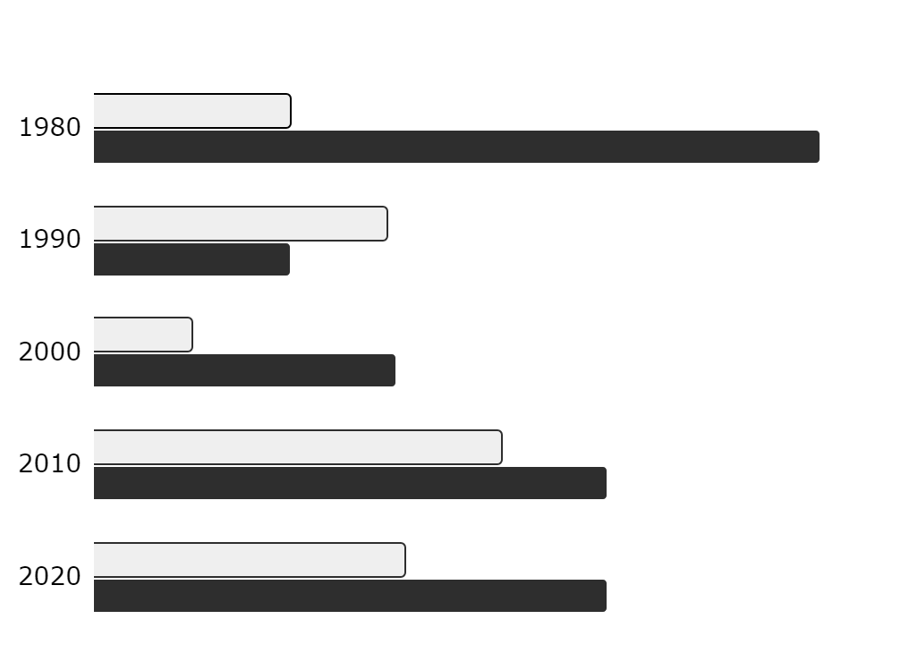
PEOPLE IN THE WORLD
Individuality
It’s the closest planet to the Sun and the smallest one
Conformity
It was named after the Roman god of wealth and agriculture
Follow the link in the graph to modify its data and then paste the new one here. For more info, click here

Slide 17
STEPS TO HAVE INDIVIDUALITY
Venus has a beautiful name
Saturn is a gas giant and has rings
Venus
Saturn
01
02
03
04
Mars
Jupiter
Mars is actually a cold place
Jupiter is the biggest planet

Slide 18
STEPS TO HAVE INDIVIDUALITY
Pluto is now a dwarf planet
Mercury is the smallest planet
Pluto
Mercury
05
06
07
08
Neptune
Ceres
Neptune is the farthest planet
It is located in the main asteroid belt

Slide 19
EXERCISE 2
Answer the following questions
Features of Conformity
Individuality vs. Individualism
You can write the answer here
You can write the answer here
Synonyms of a individuality
Types of Conformity
You can write the answer here
You can write the answer here

Slide 20
03
DIFFERENCE
You can enter a subtitle here if you need it

Slide 21
INDIVIDUALITY PERCENTAGES
Mercury
Venus
Earth
Mercury is the closest planet to the Sun and the smallest one in the Solar System
Venus has a beautiful name and is the second planet from the Sun. It’s terribly hot
Earth is the third planet from the Sun and the only one that harbors life in the Solar System
40%
80%
20%

Slide 22
TYPES OF PEOPLE
Individuality
Conformity
Age:
20 - 40
Age:
< 50
40%
Studies:
University
Studies:
Secondary
60%
Salary:
< 900 /month
Salary:
> 1000 /month
Description
Description
Mercury is the closest planet to the Sun and the smallest one in the Solar System
Venus has a beautiful name and is the second planet from the Sun. It’s terribly hot

Slide 23
INDIVIDUALITY VS. CONFORMITY
 | Definition | Types | Politicians | Synonyms
Individuality | Mercury is the closest planet to the Sun | - | Susan Bones, Timmy Jimmy, John Doe | Selfhood, identity, personality
Conformity | Earth is the third planet from the Sun | 3 | Jenna Doe | Obedience, consent, allegiance

Slide 24
150,000
Big numbers catch your audience’s attention

Slide 25
2,000
3,000
15,000
9,000
Mercury is the smallest planet
Venus is the second planet
Mars is a very cold place
Neptune is the farthest planet

Slide 26
MAP OF THE WORLD
Mercury
Mercury is the closest planet to the Sun
Venus
It has a beautiful name and is the second planet
Earth
Earth is the third planet from the Sun

Slide 27

MULTIMEDIA
You can replace the image on the screen with your own work. Right-click on it and then choose "Replace image" (in Google Slides) or "Change Picture"

Slide 28
LIKENESS OF BOTH
Mercury
Jupiter
Mercury is the closest planet to the Sun and the smallest one
Jupiter is a gas giant and the biggest planet in the Solar System
Mars
Saturn
Despite being red, Mars is actually a very cold place
Saturn is composed mostly of hydrogen and helium

Slide 29
EXERCISE 3
Read the essay below and answer the questions
Essay
Questions
Mercury is the closest planet to the Sun and the smallest one in the Solar System
Venus has a beautiful name and is the second planet from the Sun. It’s terribly hot
It's full of iron oxide dust, which gives the planet its reddish cast
Is Earth where we all live on
Is Mars actually a cold place?
Does Venus have a beautiful name?
Order from smallest to largest
Write an essay

Slide 30
04
SOCIETY
You can enter a subtitle here if you need it

Slide 31
REVIEW THE CONCEPTS
Do you know what helps you make your point clear?
Lists like this one:
They’re simple
You can organize your ideas clearly
You’ll never forget to buy milk!
And the most important thing: the audience won’t miss the point of your presentation

Slide 32
ABOUT SOCIETY
Mercury
Venus
Jupiter
Mercury is the closest planet to the Sun
It has a beautiful name and is the second planet
Jupiter is a gas giant and the biggest planet
Saturn
Mars
Saturn is a gas giant and has several rings
Despite being red, Mars is a very cold place

Slide 33


OUR TEAM
Timmy Jimmy
Susan Bones
You can speak a bit about this person here
You can speak a bit about this person here

Slide 34
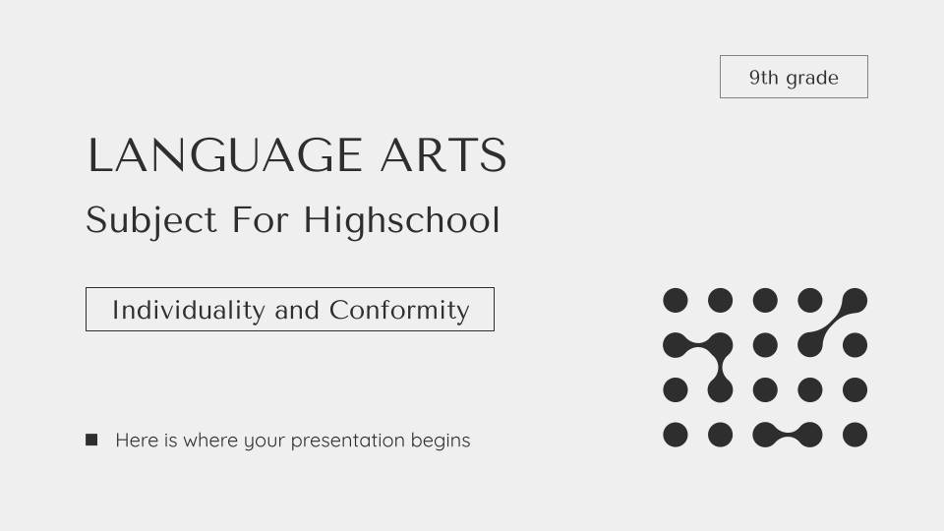
DESKTOP DEVICE
You can replace the image on the screen with your own work. Just delete this one, add yours and center it properly

Slide 35
THANKS
Do you have any questions?
youremail@freepik.com
+91 620 421 838
yourcompany.com
Please keep this slide for attribution

Slide 36
HIGH SCHOOL ICON PACK

Slide 37
ALTERNATIVE RESOURCES

Slide 38
ALTERNATIVE RESOURCES
Here’s an assortment of alternatives resources within the same style of this template
Photos
Census concept photographed town
Group people city composition
Save world protest
Close up woman leading team
Medium shot woman with stop message palm

Slide 39
RESOURCES
Did you like the resources on this template? Get them for free at our other websites:
Photos
Portrait older woman outdoors city
Smiley people giving thumbs up group therapy session
High angle teacher taking notes
Senior professor with raised hand holding pen classroom
Group people city composition
Icons
High school Icon Pack

Slide 40
Instructions for use
In order to use this template, you must credit Slidesgo by keeping the Thanks slide.
You are allowed to:
- Modify this template.
- Use it for both personal and commercial projects.
You are not allowed to:
- Sublicense, sell or rent any of Slidesgo Content (or a modified version of Slidesgo Content).
- Distribute Slidesgo Content unless it has been expressly authorized by Slidesgo.
- Include Slidesgo Content in an online or offline database or file.
- Offer Slidesgo templates (or modified versions of Slidesgo templates) for download.
- Acquire the copyright of Slidesgo Content.
For more information about editing slides, please read our FAQs or visit Slidesgo School:
https://slidesgo.com/faqs and https://slidesgo.com/slidesgo-school

Slide 41
Instructions for use (premium users)
In order to use this template, you must be a Premium user on Slidesgo.
You are allowed to:
Modify this template.
Use it for both personal and commercial purposes.
Hide or delete the “Thanks” slide and the mention to Slidesgo in the credits.
Share this template in an editable format with people who are not part of your team.
You are not allowed to:
Sublicense, sell or rent this Slidesgo Template (or a modified version of this Slidesgo Template).
Distribute this Slidesgo Template (or a modified version of this Slidesgo Template) or include it in a database or in any other product or service that offers downloadable images, icons or presentations that may be subject to distribution or resale.
Use any of the elements that are part of this Slidesgo Template in an isolated and separated way from this Template.
Register any of the elements that are part of this template as a trademark or logo, or register it as a work in an intellectual property registry or similar.
For more information about editing slides, please read our FAQs or visit Slidesgo School:
https://slidesgo.com/faqs and https://slidesgo.com/slidesgo-school

Slide 42
Fonts & colors used
This presentation has been made using the following fonts:
Tenor Sans
(https://fonts.google.com/specimen/Tenor+Sans)
Quicksand
(https://fonts.google.com/specimen/Quicksand)
#2e2e2e
#838383
#aaa9a9
#efefef
#ffffff

Slide 43





Storyset
Create your Story with our illustrated concepts. Choose the style you like the most, edit its colors, pick the background and layers you want to show and bring them to life with the animator panel! It will boost your presentation. Check out How it Works.
Pana
Amico
Bro
Rafiki
Cuate

Slide 44
Use our editable graphic resources...
You can easily resize these resources without losing quality. To change the color, just ungroup the resource and click on the object you want to change. Then, click on the paint bucket and select the color you want. Group the resource again when you’re done. You can also look for more infographics on Slidesgo.

Slide 47
JANUARY
FEBRUARY
MARCH
APRIL
MAY
JUNE
PHASE 1
Task 1
Task 2
PHASE 2
Task 1
Task 2
JANUARY
FEBRUARY
MARCH
APRIL
PHASE 1
Task 1
Task 2

Slide 50
...and our sets of editable icons
You can resize these icons without losing quality.
You can change the stroke and fill color; just select the icon and click on the paint bucket/pen.
In Google Slides, you can also use Flaticon’s extension, allowing you to customize and add even more icons.

Slide 51
Educational Icons
Medical Icons

Slide 52
Business Icons
Teamwork Icons

Slide 53
Help & Support Icons
Avatar Icons

Slide 54
Creative Process Icons
Performing Arts Icons

Slide 55
Nature Icons

Slide 56
SEO & Marketing Icons

Slide 57


